Slide 1
An Introduction To Statistical Learning with Applications in R Chapter 1
By Chapman tse

Slide 2
Introduction
This presentation is to introduce Statistical Learning through chapter 1 of “An Introduction To Statistical Learning with Application in R” by Gareth James, Daniela Witten, Trevor Hastie, and Robert Tibshirani.
What is Statistical Learning?
Statistical Learning refers to a vast set of tools for understanding data.
(Tools and concepts will be introduce later on the presentation)

Slide 3
Two Classes of Tools
Tools for Statistical learning can classified as supervised or unsupervised.
Supervised Tools
Supervised statistical learning involves building a statistic model for predicting, or estimating, an output based on one or more input.
Unsupervised tools
Unsupervised statistical learning, there are inputs but no supervising output. Still you can learn the relationships and structure from such data.

Slide 4
Three Real-world Data
In the book, it introduces three types of data that will be used to predict outputs.
Wage Data
Stock Market Data
Gene Expression Data
(Information about these three data types will introduce in next few slides)

Slide 5
Wage data
Wage Data contains data of a topic and relations to other subjects.
Example: A collection of data that contains the topic of the amount of wage related to the subjects like Age, Year, and Education level.
Regression Problem
Involves predicting a continuous or quantitative output value
Just a single criterion is Unlikely to provide an accurate prediction of the topic

Slide 6
Stock market data
Stock market data contains data for predicting the probability of a non-numerical value.
Example: The goal is to predict whether the index will increase or decrease on a given day using the percentage changes in the index from the past 5 days.
We may understand the type of customers is similar to each other by grouping individuals accordingly to their characteristics. This is known as a clustering problem.

Slide 7

Gene Expression data
Gene Expression Data involves situations in which we only observe input variables, with no corresponding output.
EX: NCI60 data set contains 6,830 gene expression measurements for each of 64 cancer cell lines. Instead of predicting a particular output variable, we are interested in determining whether there are groups, or clusters, among the cell lines based on their gene expression measurement

Slide 8
Brief History of Statistical Learning
The term “Statistical Learning” is fairly new, but many concepts that underlie the field were developed long ago.
Concepts:
Method of least squares, later know as Linear Regression
Linear discriminant analysis
Logistic regression
Generalized linear model
Classification and regression trees
Generalized Additive Models

Slide 9
Linear Regression
19th century, Legendre and Gauss published papers on the method of least squares, which implemented the earliest form of what is now known as Linear Regression.
Linear regression is used for predicting quantitative value, such as an individual’s salary
It is really easy to do in Excel.
Estimate shows the values used in the equations.
The Standard Error column quantifies the uncertainty of the Estimate.
A low Standard Error tells me that the Estimate is precise.

Slide 10
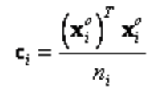



Linear discriminant analysis
To predict qualitative values, such as whether a patient survives or die, Fisher proposed linear discriminant analysis.
Linear discriminant analysis is a method used to find a linear combination of features that characterizes or separates two or more classes of objects or events.
Steps:
First split the data into groups
Then calculate the global mean
Calculate xiO by xi minus global mean.
Use the covariance matrix of group i equation:
calculate the pooled covariance matrix using the equation:
Calculate prior probability vector: pi =
After that use discriminant function:

Slide 11
Logistic Regression
In the 1940s, various authors put forth an alternative approach, Logistic regression.
Logistic regression is the appropriate regression analysis to conduct when the dependent variable is binary.
It is used to describe data and to explain the relationship between one dependent binary variable and one or more nominal, ordinal, interval, or ratio-level independent variables.

Slide 12
Generalized Linear Models
In the early 1970s, Nelder and Wedderburn coined the term Generalized Linear Models for an entire class of statistical learning methods that include both linear and logistic regression as special cases.
Three components in generalized linear models:
Linear predictor
Link function
Probability distribution

Slide 13
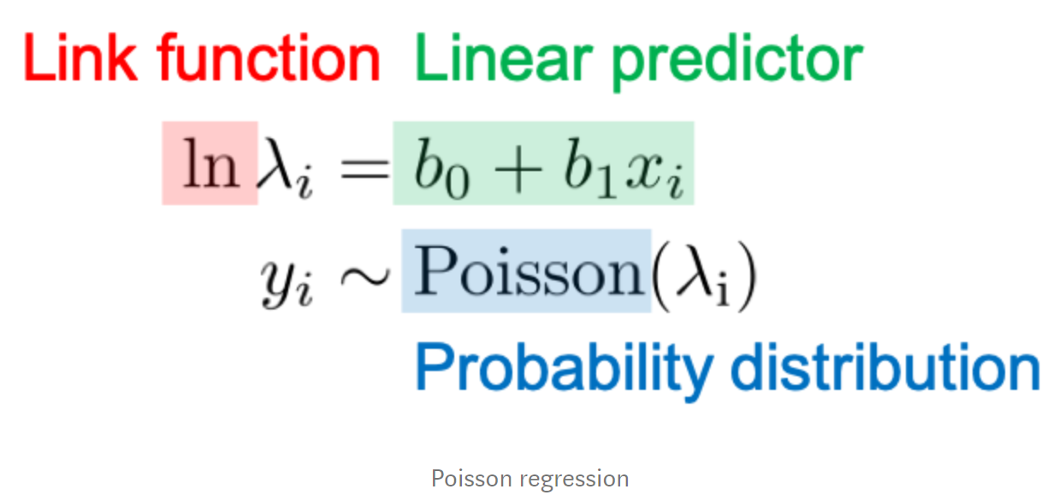
Example of Generalized Linear Models
Use Poisson regression as an example:
Linear predictor is just a linear combination of parameter (b) and explanatory variable (x)
Link function is the “links” of linear predictor and the parameter for probability distribution
Probability distribution generates the observed variable y.

Slide 14
Classification and Regression Trees
In the mid 1980s, Breiman, Friedman, Olshen, and Stone introduced Classification and Regression Trees, and were among the first to demonstrate the power of a detailed practical implementation of a method, including cross-validation for model selection.
It is a term used to describe decision tree algorithms that used for classification and regression learning task.
There are two simple definition of two kind of decision trees:
Classification Trees
Regression Trees

Slide 15
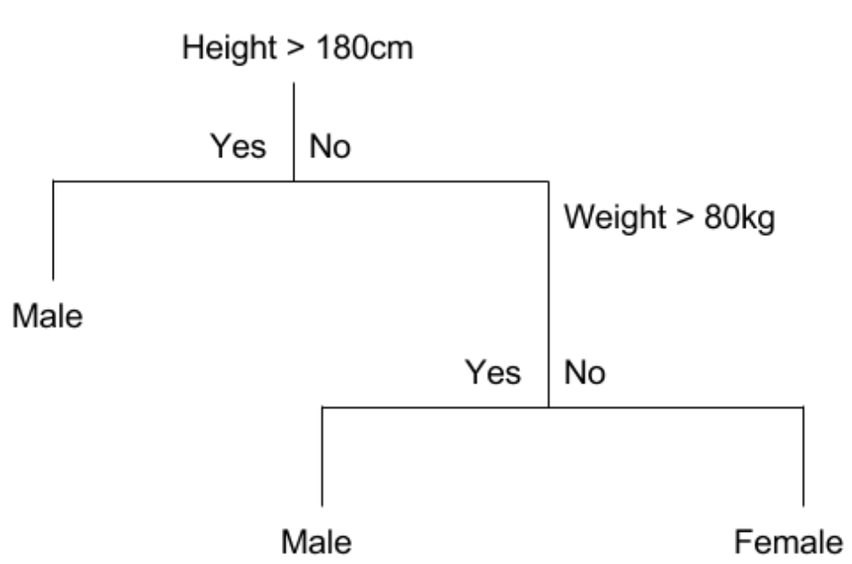
Classification Trees
Classification tree is an algorithm where the target variable is fixed or categorical
Example: Simple binary classifications where the categorical dependent variable can assume only one of two:

Slide 16
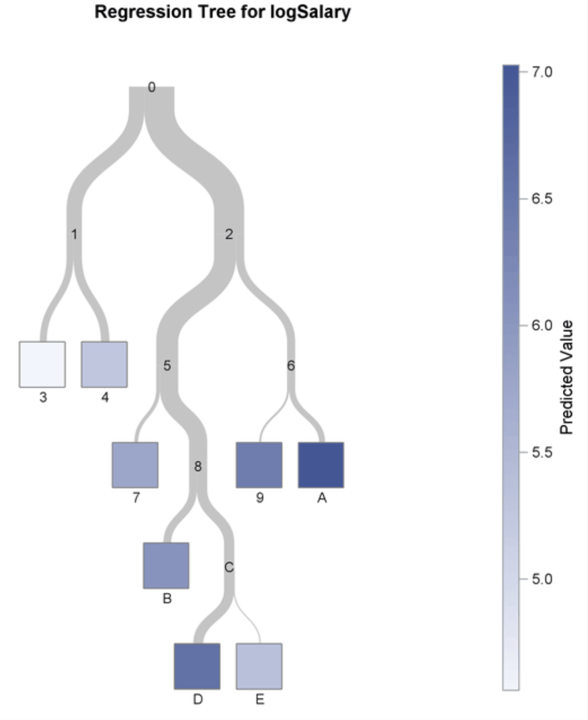
Regression Trees
A regression tree refers to an algorithm where the target variable is and the algorithm is used to predict it’s value.
Usually predict a subject by a continuous dependent variable.
Example: ----------------------------------------------→

Slide 17
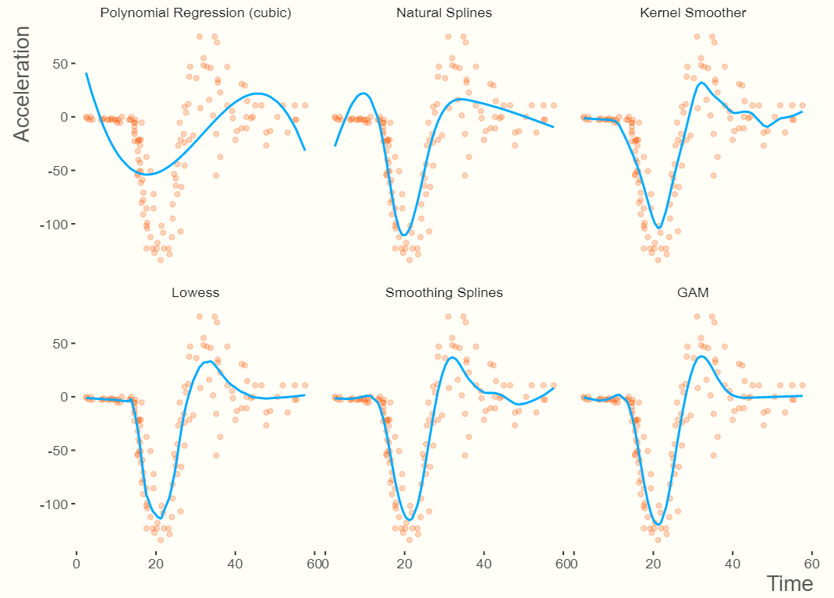
Generalized Additive Models
Hastie and Tibshirani coined the term Generalized Additive Models in 1986 for a class for non-linear extensions to generalized linear models, and also provided a practical software implementation.
Can use multiple approaches to find regression line.
For example ---------------------------------→

Slide 18
Notation and Simple Matrix Algebra
n = the number of distinct data points or observations in the sample.
p = the number of variables that are available for use in making predictions.
xij = the value of jth variable for the ith observation.
i have the max boundary of n.
j have the max boundary of p.
X = a n * p matrix whose ( i, j)th element is xij.
T notation = transpose of a matrix or vector
Vector of length n will always be denoted in lower case bold
Vector that are not length n will be denoted in lower case normal font
Matrices will be denoted using bold capitals

Slide 19



Matrix
Can be viewed as a two dimensional array.
To indicate that an object is a scalar, use notation:
To indicate that it is a vector of length k, use notation of:
To indicate an object is r * s matrix, use:
Matrix product is only available if the number of columns of A is the same as the number of rows of B.

Slide 20
References
https://home.deib.polimi.it/matteucc/Clustering/tutorial_html/
https://www.displayr.com/what-is-linear-regression/
https://people.revoledu.com/kardi/tutorial/LDA/Numerical%20Example.html
https://www.statisticssolutions.com/what-is-logistic-regression/
https://towardsdatascience.com/generalized-linear-models-9cbf848bb8ab
https://www.digitalvidya.com/blog/classification-and-regression-trees/
https://m-clark.github.io/generalized-additive-models/introduction.html

